Slide 1

Speech Synthesis for the Chuvash Language
Dante Razo
LING-L 445

Slide 2
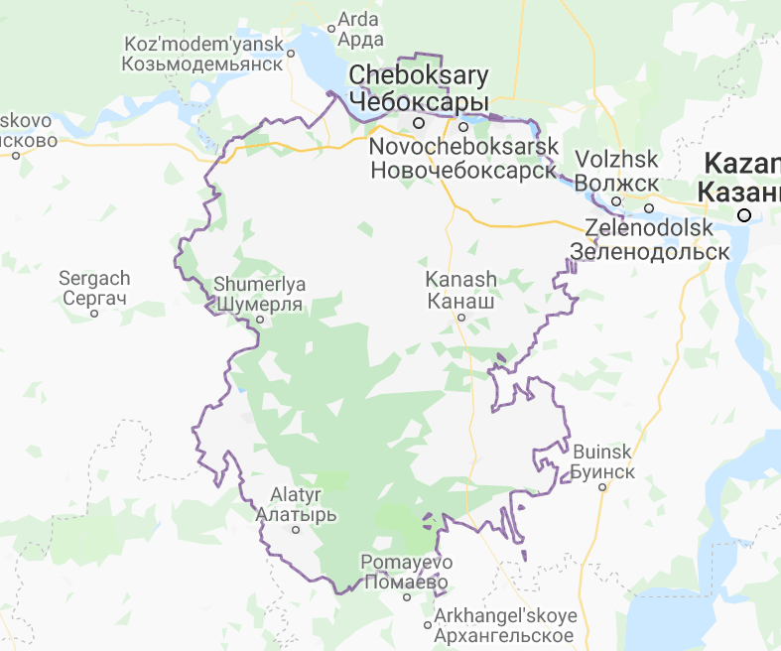
Background
Chuvash is a minority language spoken by roughly one million people in European Russia
Turkic language that utilizes the Cyrillic alphabet
This project aimed to train popular speech-synthesis systems and compare them
Notes:
Chuvash, as you may remember from our second practical,…

Slide 3
What is Speech Synthesis?
Speech synthesis is the production of artificial human speech
e.g. Bloomington Transit & IU buses, Google Assistant, Amazon Alexa
Text-to-speech (TTS) is a subset of speech synthesis
Self-explanatory name
e.g. Microsoft Sam, NOAA Severe Weather Alerts, Stephen Hawking
Notes:
Focuses on — you guessed it — turning text to speech

Slide 4
Speech Synthesis Systems
Used:
Ossian & Merlin
Attempted:
eSpeakNG
Mozilla TTS
Mozilla LPCNet
Considered:
Festival
Notes:
eSpeakNG is the “black sheep”

Slide 5

Corpora & Repositories
Corpora:
Turkic_TTS by Francis M. Tyers (ftyers)
Apertium-chv (GPL-3.0) by Apertium (apertium)
Repositories:
eSpeakNG (-cv) by Harry Zhang (contextualist)
Mozilla TTS (MPL-2.0) by Mozilla (mozilla)
Ossian (Apache-2.0) by CSTR Edinburgh (cstr-edinburgh)
Mozilla LPCNet (BSD-3) by Mozilla (mozilla)
Notes:
CSTR: “Center for Speech Technology Research”

Slide 6
Ossian & Merlin

Slide 7
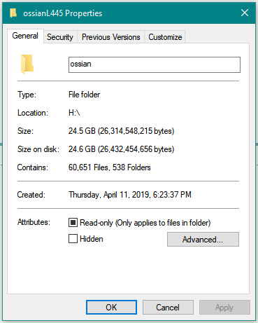
Training Ossian

Slide 8
eSpeakNG

Slide 9
Configuring eSpeakNG

Slide 10
Model Evaluation & Results

Slide 11

Example
“Ытти чӗлхесемпе пӗрлех ку хатӗрте чӑваш чӗлхи валли те вырӑн тупӑннӑ”
From apertium_chv corpus (/texts/cvorg-commonvoice.txt, line 2)

Slide 12
References
Russian Bureau of Statistics: Владение Языками Населением Российской Федерации [Population of the Russian Federation by Languages]
http://www.gks.ru/free_doc/new_site/perepis2010/croc/Documents/Vol4/pub-04-05.pdf
Wikipedia: Speech Synthesis
https://en.wikipedia.org/wiki/Speech_synthesis
Wikipedia: Chuvash Language
https://en.wikipedia.org/wiki/Chuvash_language

Slide 13
Special Thanks
Harry Zhang
And viewers like you
Notes:
Harry Zhang: for his advice on audio preprocessing and work on implementing Chuvash to the eSpeak library
Viewers: This presentation was made possible in part by viewers like you. Thank you.

Slide 14
Fin

